Slide 1
MASCONOMET REGIONAL HIGH SCHOOL
Social and Emotional Learning Programming

Slide 2
Our Staff
Kevin Lyons - Superintendent
Peter Delani - Interim High School Principal
Alyssa Schatzel - Interim High School Assistant Principal, Lower School 9th & 10th Grades
Steve Burt - Director of Security & Crisis Response
Julianna O’Day - Adjustment Counselor/Peer Leader Advisor
Ben Hanchett - Student Council Advisor, Social Studies Teacher
Kristin Duffy - Adjustment Counselor/Student Support Center
Alicia Gomes - Health & Wellness Teacher/Certified Counselor

Slide 3
Central Tenets of Masco Programming
Teach every child
Build a School around Psych/Social Development
If we nurture the student and honor the soul, then psych social/emotional maladies will fade (Treat the Root - not the symptoms)
Student Engagement
Students Affect Outcomes
An engaged student who is called upon to affect outcomes (succeed/fail) is one who doesn’t lash out at others, but rather respects others for the gifts they have to offer
Through our successes we build confidence, and through our failures we gain wisdom

Slide 4
Keys to Building SEL Programming:
Be cognizant this is a FLUID process
Identify what you already have in place
“Pull a thread” through it
Identify gaps
Recognize SEL growth is not LINEAR
Don’t worry about measuring everything
Staff it from the ‘underbelly’

Slide 5
We Began With A Question
1997 prepared to build a new high school due to open in 2001
“Masco” was going to double in population from 700 - 1400
Central Question was: How do we maintain “Masco” (student centered; academically successful; students felt connected to adults and believed adults cared about them; community oriented environment) when we are going to double in population?

Slide 6
From a Tragedy, a Book & a Speaker came an Idea
A Tragedy
1998: Columbine occurred right in the middle of our new high school design stage.
A Book
Care of the Soul: Thomas Moore
20th Century American Medicine/Psychology vs. Renaissance
Depression vs. Melancholy
A Speaker
Dan Kindlon, Raising Cain
An Idea
Peer Leader Program/Frosh Orientation
Emotional Literacy Workshops
Focus on Root (Soul) not the symptoms
Became a School - new Masco opened in 2001

Slide 7
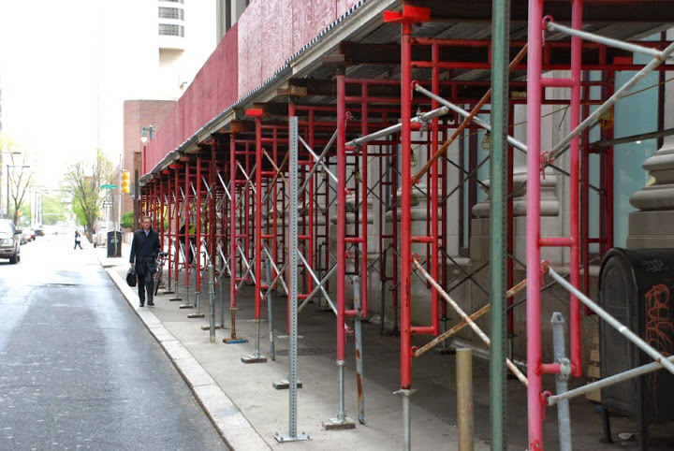
The Staging Process - 20 years in the making
1997-2000: Design a new school physically & philosophically
1998 - 2001: Design & implement House System
1999 - 2002: Build Peer Leader Program & Emotional Literacy Workshops
2002 - 2006: Transform Alternative Program into early staging of our Student Support Center as we recognized changing issues and challenges students were bringing to school.
2004 - 2017: Transform Hall Monitors into our Director of Security and Response
2011 - 2017: Transform our Health & Wellness Programming: Yoga Classes, Project Adventure, etc
2014 - 2025: Develop & Implement Vision 2025:
Plan for new Medical Center: “Triage Model”

Slide 8
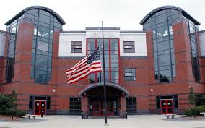
The House System: Physical Design of HS matches
Educational Philosophy
Unique opportunity to design building physically & emotionally
House System designed to allow students time to grow emotionally, physically and academically
Recognized there are significant differences and needs of a 15 and an 18 year old
Assistant Principals - Leaders and Experts of their Houses
Broken out by Lower & Upper School, not alpha or rotating)
Separate Lunches
Lockers, Home Rooms, Hallways

Slide 9
Peer Leader Programming - Julianna O’Day
Acknowledge our issues & transform the culture
Make successful transitions from one grade to another
Peer Leader Program began in 1999
Freshman Orientation Program becomes year long orientation with monthly programming
Peer Leader Coordinator also an Adjustment Counselor in our Student Support Center
Transforming the Peer Leader Program as times change -
Tying into our K-12 Initiatives
Senior Internships/going back to Middle and Elementary Schools as Capstone Experiences
Peer Tutors & Peer Groups for Social & Emotional Learning Support

Slide 10
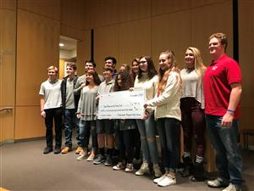
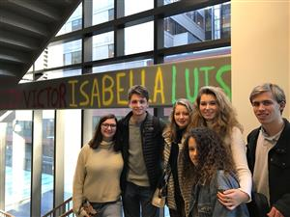
Peer Leaders & Freshman Walk: Masco In Motion
Since 1999 Masco Peer Leaders & Freshmen Classes have raised over $450,00 for Charities such as the: Jimmy Fund; Doug Flutie Jr. Foundation for Autism; Cystic Fibrosis; Lymphoma/Leukemia Society; Dana Farber Cancer Society; Make a Wish Foundation; Boston Children’s Hospital; and Thomas Smith Foundation for Paralysis; - all charities are chosen organically by our Peer Leaders and Freshmen Class

Slide 11
Evolution of our Student Support Center - Kristin Duffy
Eliminated our Alternative Program
Moved towards Inclusion Models
Problems change from physical altercations, drugs/alcohol, smoking, attendance, fighting to Psych/Social Issues.
Stopped Band AID approach
Knew we needed to adapt to changing problems/challenges
Hired Kristin Duffy
Transition from In School Suspension processing to Student Support Center
Focusing on supporting students with both mental health and medical needs and transitioning students back from long term absences.
Student Support Staff grows from
2004 = 1 Adjustment Counselor & 4.5 Guidance Counselors
2017 = 3.5 adjustment counselors, 2 full time aides & 6.5 Guidance Counselors
All of our Student Support Center Adjustment Counselors are Licensed Mental Health Counselors & Certified School Adjustment Counselor with work experience in both residential outpatient settings.

Slide 12
Development of our Director of Security & Crisis Response - Steve Burt
1950s - 80s: Teachers in hallways for Duty Period
80s - 90s: Part-time Hall Monitors
Early 2000s - Security Person background in retail
2007 Hired Steve Burt as Security Coordinator (10 month)
Military, police and Healthcare Security experience with mental health training.
Embedded the position into the fabric of our school by direct involvement and input in more groups dealing with student support & culture, classrooms,SHAC, CCI, RTI etc
School liaison for Public Safety agencies. Background has assisted with bridging gap and establishing better communication with police, courts, SRO’s due to speaking the language that traditional educators aren’t necessarily versed in.
2017/18: Position becomes 12 month, full time Administrator (Director of Security & Crisis Response
Oversight of crisis response, emergency plans & readiness, security program and related trainings for district personnel. Continuing foundational work and roles as well.

Slide 13
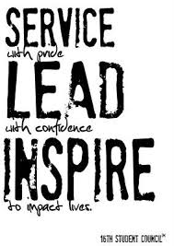
Transformed our Student Council - Ben Hanchett
Ben transformed the Masconomet Student Council into a service leadership group
TAG LINE: “Serving the Community”
Serving both the school community & Tri-Town Community
Events/Programming designed to benefit a wide cross section of the community
St. Patrick’s Day Dinner for Senior Citizens
Cor Unum - meal service
K-12 Programming
Connecting with & Modeling for Elementary Student Councils

Slide 14
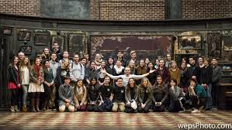
Embedding the Curriculum
Masco: IT’S OK TO BE WHOMEVER YOU WANT TO BE
Yearlong Freshman Orientation Program - with monthly themes
Student Engagement
Freshman English Question: “Who am I and how do I know?”
Sophomore English Question: “What is the right relationship of the individual to others?”
Art Program wide Theme: Alter Ego, Journeys, Cultures (personal)
Music Free Form Fridays
“Anti-Bullying” programming built into Sophomore English Course & Frosh Peer Leader Programming
Health & Wellness Programming
YRBS
SBIRT
Clubs
LGBTQ
Gender Studies
Race & Ethnicities

Slide 15
Wellness Programming - Alicia Gomes
Comprehensive Health Programs:
SOS (Signs of Suicide)
Wellness Unit: Stress Management
Collaboration with Director of Safety and Crisis and Response as a guest speaker in class
Freshman Seminar: PE teachers work with Guidance Counselors
Stress Relief 101 Course: Co-taught with adjustment counselor & PE teacher.
Yoga I & II: Combining physical and mental wellness.
“During meditation I become more intact with my body and aware of my pattern of breathing. With each flow of energy and breath, I pushed away any pain/tension within my body. After becoming completely relaxed and free of any stress, I started thinking of the places where I feel most comfortable and at peace. This reminded me of my trip to Maine and just sitting on the dock staring out into the open water.” – 9th grader
“During this meditation I thought about how I don’t love myself as much as I should because I am beautiful. I thought about how my depression and anxiety don’t control me. And, I thought about how I should love myself as much as I love everyone around me. I should love me because I am amazing and beautiful and have a wonderful life. “ – 11th grader

Slide 16
Where we’re Headed - Dr. Kevin Lyons
Vision 2025
K - 12 Initiatives
exSEL: the Rennie Center
SEL continues to be central to our School Improvement Plans
Have classrooms and teaching strategies embedded with SEL skills to teach every student
Medical Center

