Slide 1
Using Data to Guide Instructional Decisions in the Social, Emotional, and Behavioral Domains
Special thanks to Dr. Pamela Plumer, NPS Director of Student Services, who brought the SDQ and related practices to NPS.

Slide 2
Strengths and Difficulties Questionnaire www.sdqinfo.com
  Well-researched/developed tool
  No cost for the tool
  Provides results in categories that can be linked to varied interventions (Hyperactivity, Conduct, Prosocial, Peer Problems, Emotional)
  Can be used for follow-up after interventions

Slide 3
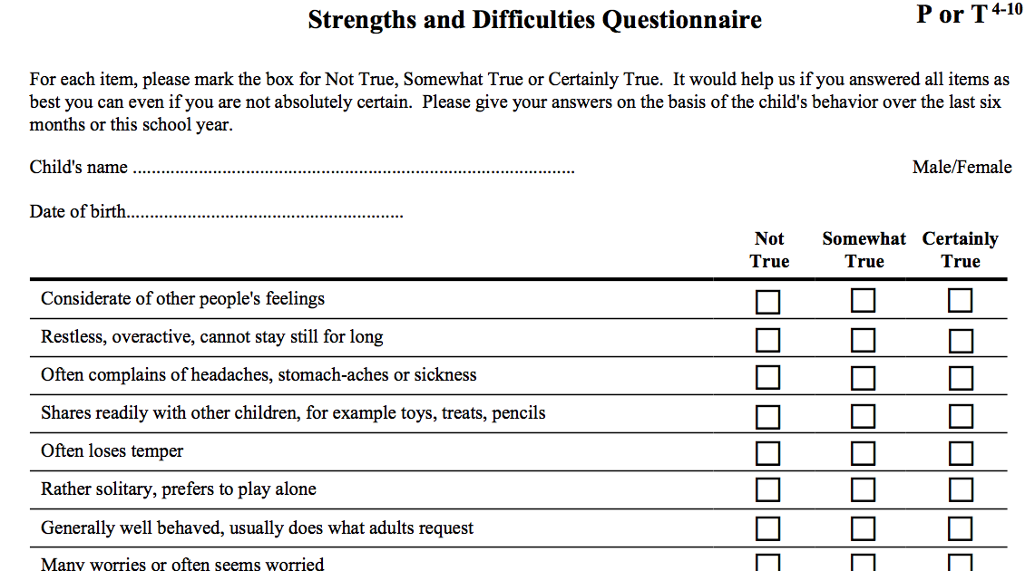

Slide 4
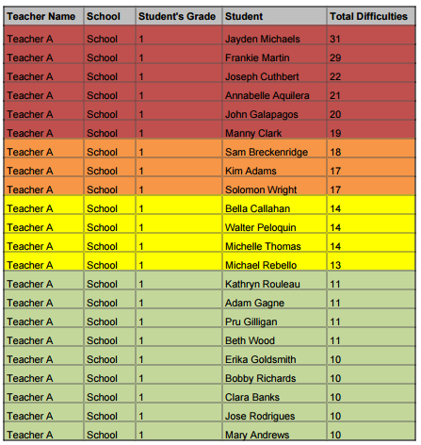
Demonstrating the “high needs future”
Data organized by student and by class*
Spring 2016 Results:
Elementary Schools: Approximately 26.9% with elevated scores (outside of the average range)
Fall 2016 Results:
Preschool:
41.7% with elevated scores
Middle School Self-Reports
12.8%-17.1% with elevated scores
* Data on this table are “phony” - created for this presentation (names are not real students)
Notes:
Pam
Elementary Schools - 26.9 K-5 showed some level of risk, 9.3 (100 students were in the Very High Range)
JFK: 12.8%-17.1% elevated
Preschool: 41.7 elevated

Slide 5
Teacher or Grade Level Meetings
Members of the initial school team that reviewed the SDQ data present to either individual teachers or at grade-level meetings
Provide and review classroom data for the students for each category
Emphasize importance of the problem solving process, data used as conversation starter
Review students with elevated scores in each category
Discuss overall results - Is there a need for a classwide intervention/approach?
Discuss individual students - Do supports currently exist? Are the right supports in place?

Slide 6
Creating a “Menu” of Interventions/Strategies
Examples of current tools utilized:
Tier 3:
Individual support/counseling provided through IEP
Specific behavior plan
Tier 2:
Short term social skills group
Targeted short-term work in a classroom group for self-regulation
Use of sensory tools/spaces
Tier 1:
(Highlighted interventions added after we received SDQ results)
Second Step, Responsive Classroom
TABATAS, GoNoodle, Acting with Purpose, Zones of Regulation

Slide 7
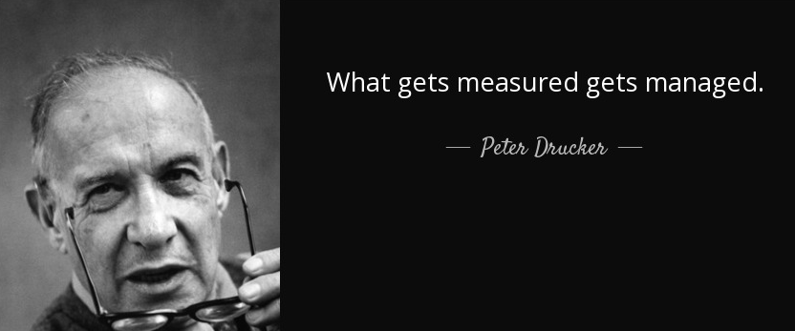
Strategies Prompted by Our Data
Focus on Tier 1 Classroom and Schoolwide Supports
Focus on Primary Grades

