Slide 1
Student & Staff Feedback in Educator Evaluation
Notes:
Massachusetts Department of Elementary and Secondary Education
1

Slide 2
Background
As of 2014-15*,
  Student feedback became an evidentiary component of a teacher’s summative performance evaluation
  Staff feedback became an evidentiary component of an administrator’s performance evaluation
  *Amended from initial regulatory timeline of 2013-14

Slide 3
Evidence to Inform the Summative Performance Rating
Products of Practice
Artifacts
Multiples Measures of Student Learning
Assessments (formative, summative, etc.)
Student and Staff Feedback
ESE Model Feedback Surveys
Focus groups, exit slips, discussion prompts, etc.
Observations
Student work, homework, etc.
Notes:
Student and staff feedback is one of three types of evidence that inform an educator’s summative performance evaluation, all of which must be taken into consideration holistically. There is no quantitative weight or value associated with any form of evidence, including feedback.

Slide 4
WHY is feedback from students and staff so important?
“My areas of strength and growth are no mystery to my students. Opting to let students discuss my practice through an anonymous survey allowed me to use relevant evidence, while, most importantly, increasing the intangible — student respect and engagement.” –Aaron Stone, Teacher, BPS
"Two-way communication between teachers and students is a cornerstone of effective practice. I have been utilizing surveys for several years to gauge how effective different assessments or other learning activities in my classroom are. The feedback helps informs my practice.“ –Rebecca Duda, Teacher, Dracut

Slide 5
WHY is feedback from students and staff so important?
Informs professional growth and development
Gives students and staff a voice in their experiences
Contributes to a comprehensive picture of an educator’s practice
Notes:
ANIMATED SLIDE

Slide 6
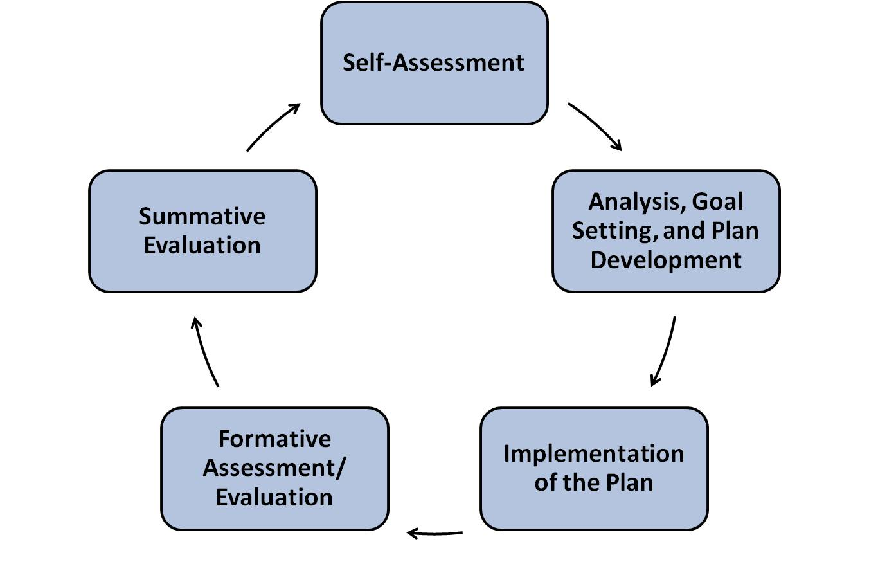
WHEN do educators collect feedback?
Districts have flexibility regarding how and when to incorporate feedback into an evaluation cycle
  Formative
  Summative
  Both
Notes:
Educator may collect feedback at any point throughout the 5-step cycle.
Just like the other two types of evidence that inform the Summative Performance Rating, there is no specific weight accorded to or point value associated with feedback in an educator’s evaluation. Districts have the flexibility to determine how feedback informs the Summative Performance Rating. Feedback may be gathered at multiple points in the 5-step evaluation cycle and considered formatively, summatively, or both. Based on recommendations from stakeholders and research partners, ESE is recommending feedback be used more formatively--to inform an educator’s self-assessment, shape his or her goal-setting process, and/or demonstrate changes in practice over time.

Slide 7

Example: Shaping goals & communicating with students
Notes:
Example from a teacher who based her mid-year goals around feedback collected from students via survey. Posting these goals in her classroom communicated to her students the value of their voice, and her commitment to their feedback.

Slide 8
WHAT are educators using to collect feedback?
Individualized instruments
Common school- or district-wide instruments
Combination of both
Notes:
ANIMATED SLIDE
Districts have flexibility in the identification of feedback instruments for educators. They may choose to implement district-wide feedback instruments, such as student or staff surveys, or they may create processes by which educators and evaluators can identify feedback instruments at the individual educator level. These approaches are not mutually exclusive, and leaders may settle on a combination of district-wide and educator-specific instruments in order to best meet the needs of all educators.
Individualized instruments may be ideal in schools and districts where collecting feedback more systematically is anxiety-producing. The fact is that most educators solicit feedback from students and staff on a regular basis—tapping into existing instruments or mechanisms is a great starting point.
Common measures, such as school or district wide surveys, are great for districts looking for a way to ensure consistency across feedback instruments. They also provide schools and districts with an opportunity to collect and aggregate data, identifying trends or patterns in student feedback that can further inform professional development, or school or district improvement plans.
Many districts combine both strategies, particularly where there are educators in more specialized roles for whom common surveys or instruments may not work for them.
All three paths are valid and rewarding—as long as you consider three important principles for high quality feedback.

Slide 9
Three Principles of High Quality Feedback Instruments
Feedback should be aligned to one or more MA Standards and Indicators for Effective Teaching Practice or Administrative Leadership so that it yields information that is relevant to an educator’s practice.
Feedback should be informative and actionable.
Instruments must be accessible to all potential respondents so that the information they provide allows educators to draw valid conclusions.
Notes:
ANIMATED SLIDE
The following principles offer best practices for districts to consider when making decisions about student and staff feedback instruments; they are intended to be applicable regardless of the method for collecting student and/or staff feedback.
Aligned to standards: not only does this ensure that a feedback instrument is capturing information that’s relevant to effective practice, it makes it possible for educators to triangulate student feedback to other types of inputs around practice, from observational feedback to artifacts of practice.
When feedback is informative and actionable, educators can make immediate and relevant use of it to their practice, which is the ultimate goal.
Finally, any feedback instrument should be accessible to all potential respondents.
A variety of feedback mechanisms can and will meet these criteria.

Slide 10
ESE Tools & Resources
ESE Model Surveys
Online Option
Additional Instruments & Strategies

Slide 11
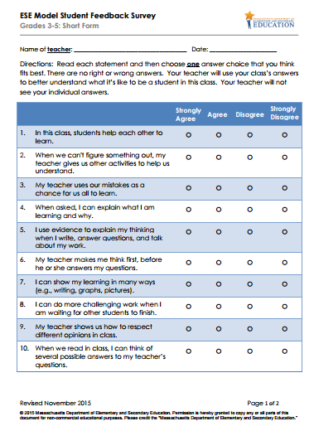
ESE Model Feedback Surveys
Student Surveys (Grades 3-5 and 6-12)
  Standard, Short, Mini*
Staff Surveys
  Standard, Short
  *New mini forms!
http://www.doe.mass.edu/edeval/feedback/surveys.html
Notes:
ESE Model Survey items are designed to yield actionable information about practice. Built on the premise that educators deserve high quality feedback, the survey items reflect day-to-day practice and yield meaningful and actionable information for educators.
Surveys development was directly informed by Massachusetts educators and students. ESE is indebted to the more than 2,200 students, parents, teachers, and school and district administrators who provided input throughout the survey development process.
ESE Model Surveys are Massachusetts-specific and aligned with the Standards for Effective Teaching and Effective Administrative Leadership Practice.
The ESE Model Student Surveys for Grades 3-5 and Grades 6-12 are vertically aligned, meaning that although they include language that is developmentally appropriate for different age groups, the items on each survey are similar and cover the same constructs. This alignment underscores the importance of common practices associated with effective teaching across grade levels.
ESE Model Survey items were developed and validated through pilot administration with Massachusetts students and administrators—over 10,000 Massachusetts students and 1,500 Massachusetts educators piloted survey items in 2013-14.
Mini Forms. In response to many educators who were interested in the surveys but not completely comfortable with administering full-length, highly diagnostic forms, we developed mini-forms. Although they lack the diagnostic value of the longer forms, they’re a great option for teachers who are new to surveys, or those who are simply interested in taking a quick temperature of their students. In just 8-10 items, you can capture student feedback on key aspects of your practice related to Curriculum, Planning Assessment (Standard I), Teaching All Students (Standard II), or both!

Slide 12
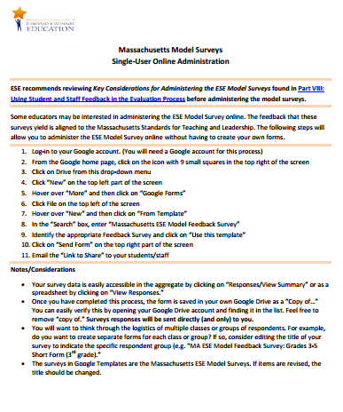
ESE Model Feedback Surveys: Online option
Individualized Use
Google Templates
http://www.doe.mass.edu/edeval/feedback/SSF-SingleUserAdmin.pdf

Slide 13
Additional Instruments
K-2 Discussion Prompts
Adapted Model Student Survey (for students with significant cognitive disabilities)
Interview/Focus Group Discussion Protocol (aligned to principles of inclusive practice)
Alternative Strategies (job-embedded tools)
  Classroom Suggestion Box
  Exit Slips
  Entrance Tickets
  Letter to Next Year’s Students
Notes:
K-2 Discussion Prompts: The K – 2 discussion prompts represent a subset of items that were piloted with students in Kindergarten, first, and second grades during the ESE Model Pilot Survey Project. These items are intended to serve as discussion prompts for early elementary teachers to use with their students to collect feedback about their practice. http://www.doe.mass.edu/edeval/feedback/K2DiscussionProtocol.pdf
Adapted Model Student Survey: This survey contains simplified items adapted from the Massachusetts Model Student Feedback Survey. Although these items assess roughly the same content as the Model Survey, their use is intended for students with significant cognitive disabilities. Including all student populations in school-wide initiatives is an essential component of an inclusive school setting.
Discussion Protocol: Student discussions provide an alternative to student surveys by tapping into aspects of accessible instruction and positive behavior supports that surveys may not capture. Through dialogue, students may provide rich and more descriptive information about particular aspects of the classroom experience. This protocol includes student discussion questions that can be used with individual students or groups of students, as well as directions on what should be considered prior to administering the discussion protocols and how results can be used.
Alternative Strategies: These alternative protocols are designed to meet the individual needs of an educator or a specific group of students and may or may not be administered district wide. Similar to more systematic survey results, feedback from alternative strategies can be used as evidence in the evaluation process and in conversations between educators and evaluators.

Slide 14
ESE Resources
Quick Reference Guide: Student & Staff Feedback
Guidance on Student and Staff Feedback
ESE Model Feedback Surveys & Protocols
Alternative Strategies (aligned to principles of inclusive practice)
Considerations for Collective Bargaining
ESE/MASS Video Series and Training PPT
SSF Webpage: http://www.doe.mass.edu/edeval/feedback/

