Slide 1
The Behavior Side of the Triangle
Making Strides to Support Social Emotional Learning
Burlington Public Schools
Patrick Larkin - Asst. Superintendent
Susan Astone - District RtI Administrator
Dec.14, 2017

Slide 2
Burlington, Massachusetts
Northwest of Boston - 13 miles
Square Miles - 11.88
Population
Residents - 25,000
Daytime - 150,000
Industries - technology, medical, business, hotels, shopping and restaurants
Notes:
Brief

Slide 3
Burlington School District - Total Students 3,500
High School - Total Students 1,000
Middle School - Total Students 820
Elementary K-5 - Total Students 1,600
Francis Wyman - 545 students, 5 sections per grade
Fox Hill - 390 students, 4 sections per grade
Memorial - 375 students, 4 sections per grade
Pine Glen - 295 students, 3 sections per grade
Special Education Integrated Preschool - Total Students 120
(Total Elementary - 1,561 students
Notes:
Brief

Slide 4
Subgroups
ELL Population
Elementary 16-25%, Middle School 8%, High School 10%
Sample of the 41 languages spoken by students and their families (list is alphabetical):
Arabic, Bengali, Cantonese, Cebuano, Czech, English, Filipino, French, French Creole, Greek, Gujarati, Hindi, Italian, Japanese, Kannada, Kikuyu, Kiswahili, Korean, Kutchhi, Langi, Luganda, Lusoga, Malayalam, Mandarin, Marathi, Nepali, Polish, Portuguese, Romanian, Rukiga, Runyankore, Russian, Sinhala, Somali, Spanish, Tamil, Telugu, Thai, Urdu, Vietnamese, Visayan
Special Education Students (Elementary Schools) 11% to 12%
Notes:
Brief

Slide 5
Elementary SEL Supports
All Schools have one dedicated School Psychologist (MTSS/Sped)
Two schools -
Assistant Principal
2 Guidance Counselors
Two Schools -
1 Guidance Counselor
District Social Emotional Learning Coach (PreK-12)
Notes:
Brief

Slide 6
District Special Education Program - TARGET
Therapeutic Acquisition & Regulation to Gain Educational Targets (TARGET)
K-2
3-5
2 teachers
1 Instructional Assistant
Social Worker
Notes:
Brief

Slide 7
University of Massachusetts, Boston Campus
Graduate Students in School Psychology and Psychology
CAGS/Ph.D.
Participate in meetings
Share research and current information
Support MTSS initiative
Notes:
Brief

Slide 8
June 2015
Academics supports are effective, the process is relatively smooth, and there is fidelity across the schools.
Behavior supports are available but schools utilize various approaches.
Schools reported they needed more help with students who were taking up a lot of time/personnel with too much time spent reacting.
No data, no fidelity to decision-making around Tier 1,2,3,Sped, or common curriculum
How could we organize our behavioral supports more like our academic supports?
“Behavior Supports” identified as our focus to 2015-2016
Notes:
Academic side going very well - Focus on Behavior Side

Slide 9
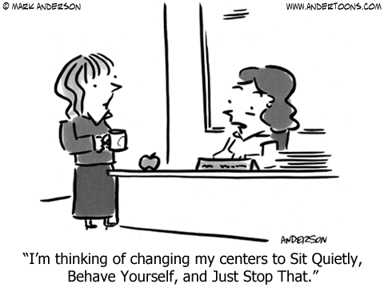

Slide 10
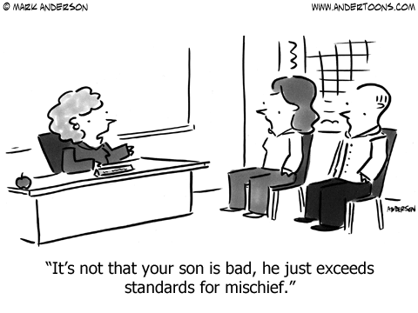

Slide 11
Current Summary of Supports 2017-2018
Tier 1 -
PBIS
Responsive Classroom
Tier 2&3 -
Social Thinking/Zones of Regulation
McLean Hospital Strategies
Dr. Hanley Life Skills - lessons/classroom systems
Universal Screener
DESSA Mini and DESSA
3 times a year for screener and 3 times for mid-period review
Student Progress and Plans
SEL Team and SEL Data Spreadsheet
Jess Minehan FAIR plans
Professional Development
Responsive Classroom
McLean Hospital Outreach

Slide 12
Focus
Tier 1
PBIS School-wide
Responsive Classroom
Data/Universal Screener
2015 - 2016

Slide 13
HOW MUCH TIME REACTING?
HOW MANY STUDENTS?

Slide 14
Data Collection
Proactive/Reactive T Chart
Determined Categories for Reasons
Log of Reactive Interruptions
Who? - Name(s)
When? - How long?
Why ? - Reason
Where? - Location/Subject
Collected and tabulated weekly in either paper form and google form
Feb.-March 2016

Slide 15
Questions Answered
How much time? 200 hours
5 weeks of work for one guidance counselor
How many students? 200
More than expected

Slide 16
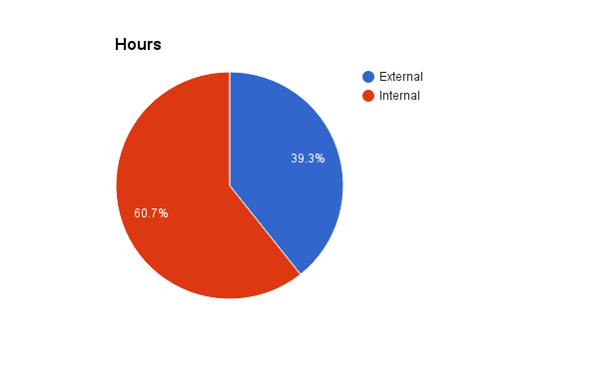
District Externalizing vs. Internalizing
Feb/Mar Combined

Slide 17
Devereux Student Strengths Assessment
Comprehensive System
Personal Responsibility
Optimistic Thinking
Relationship Skills
Self-Awareness
Self Management
Goal Directed Behavior
Social Awareness
Decision Making
DESSA Mini and DESSA

Slide 18
Why the DESSA ?
Strength - based focus
Positive language for students, teachers, and parents
DESSA Mini - quick and easy screener
Valid/Reliable results
Ability to drill-down with DESSA to determine skills and write clear goals
Progress monitoring options available with multiple DESSA Mini forms
Includes lessons as well as capability to add district lessons
Aligns with Responsive Classroom with classroom applications ( Crosswalk)

Slide 19
Devereux Student Strengths Assessment
DESSA Mini
8 questions
1-2 minutes per student
20 minutes total per class
Overall score - T-score and percentile score
DESSA (Full)
72 questions
15 minutes per student
Identifies strength/typical/need for each category
Teacher Ratings
How often teacher SAW the behavior during the past 4 weeks:
Never
Rarely
Occasionally
Frequently
Very Frequently

Slide 20
Universal Screening Periods
*October/November - DESSA Mini / DESSA for selected students
December - Review DESSA Mini results and interventions
*January - DESSA Mini/ DESSA for selected students
February - Review DESSA Mini results, progress, and interventions
*May - DESSA Mini / DESSA for selected students
June - Review DESSA Mini results, progress, and interventions

Slide 21
Focus
Tier 2&3
PD - Tier 2 & 3 Interventions
Focus on Student Plans
Full Implementation of DESSA Comprehensive System
2016-2017

Slide 22
PD for Tier 1, 2 and 3
Tier 1 - Responsive Classroom Training (link)
30 teachers
4 Days in August
Tier 2 - Zones of Regulation Training ( Social Thinking) ( link)
Guidance and School Psychologists
1 Day August & purchase materials
Tier 3 - McLean Hospital Outreach ( link)
Guidance and School Psychologists
Every other Friday morning, Oct-June

Slide 23
Student Plans
School Psychologists complete plans at Grade Level Meetings or Problem Solving Team Meetings
Guiding Questions (Jessica Minahan, M.Ed., BCBA):
1.In three sentences or less, what is the behavior of concern?
2.When/where is this behavior/concern most likely to occur?
3.When/where is this behavior/concern least likely to occur?
4.What underdeveloped skills do you think are underlying the behavior/concern?
5.What strategies/interventions have been helpful and are currently in place to address the underdeveloped skills?
6.What strategies /interventions have been tried and were not helpful after consistent implementation?
7.What are the triggers of the behavior/concern?
8.What is the response/result of the behavior/concern typically?

Slide 24
Student Plans - continued
Tier 2 or 3 Intervention Plan
Focus Skill:
Accommodations
Strategies
Explicit Teaching
Who/Where

Slide 25
Sample SEL Spreadsheet
DESSA Mini and DESSA Ratings
Target Skill Area : DESSA’s 8 categories
Supports/Interventions: Classroom , Guidance, School Psychologist
Other Staff : SEL Coach, Speech Language Pathologist for pragmatics
Tier Decision – I,2,3, IEP,504
Additional Notes - Open field

Slide 26
Focus
Alignment/Integration
Tier 1
Read Aloud Book List aligned to DESSA Categories
Integration of PBIS, RC, Zones in classrooms
Tier 2& 3- Crosswalk of Intervention Options aligned with DESSA Categories
Specialists -Responsive Classroom one day training for special area teachers
2017-2018

Slide 27
Questions?

